Slide 1
Query Processing Part II
CS- 212
Distributed Database Systems
Ms. Mariam Nosheen
Computer Science Department, LCWU, Lhr

Slide 2
Outline of todays Presentation
Query Processing
Query Decomposition
Ms. Mariam Nosheen
CS- 212 Distributed Database Systems

Slide 3
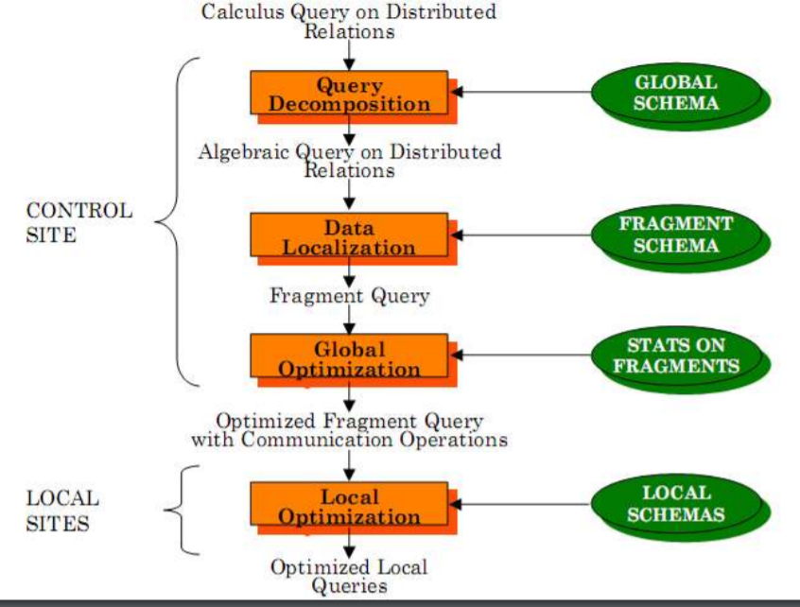
Distributed Query Processing Methodology
Query Processing
Ms. Mariam Nosheen
CS- 212 Distributed Database Systems

Slide 4
Normalization
Query Processing
Ms. Mariam Nosheen
CS- 212 Distributed Database Systems

Slide 5
Analysis
Query Processing
Ms. Mariam Nosheen
CS- 212 Distributed Database Systems

Slide 6
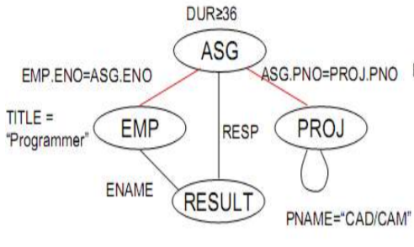
Analysis – Example
Query Processing
Ms. Mariam Nosheen
CS- 212 Distributed Database Systems

Slide 7
Analysis
Query Processing
If the query graph is not connected, the query is wrong.
SELECT ENAME,RESP
FROM EMP, ASG, PROJ
WHERE EMP.ENO = ASG.ENO
AND PNAME = "CAD/CAM"
AND DUR ≥ 36
AND TITLE = "Programmer"
Ms. Mariam Nosheen
CS- 212 Distributed Database Systems

Slide 8
Elimination of Redundancy
Query Processing
Why simplify?
➠ Remember the example
How? Use transformation rules
➠ elimination of redundancy
idempotency rules
p1 ∧ ¬( p1) ⇔ false
p1 ∧ (p1 ∨ p2) ⇔ p1
p1 ∨ false ⇔ p1
…
➠ application of transitivity
➠ use of integrity rules
Ms. Mariam Nosheen
CS- 212 Distributed Database Systems

Slide 9
Elimination of Redundancy – Example
Query Processing
SELECT TITLE
FROM EMP
WHERE (NOT(EMP.TITLE = “Programmer”)
AND (EMP.TITLE = “Programmer”
OR EMP.TITLE = “Elect. Eng.”) AND NOT(EMP.TITLE = “Elect. Eng.”))
OR EMP.ENAME = “J. Doe”
P1
P1
P2
P2
P3
P3
Ms. Mariam Nosheen
CS- 212 Distributed Database Systems

Slide 10
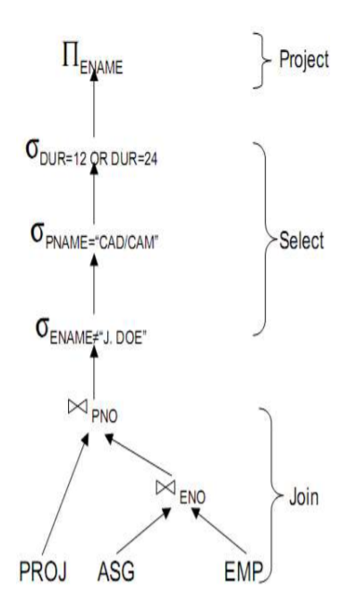
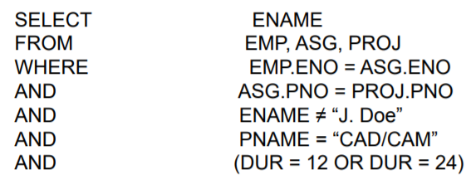
Rewriting
Query Processing
Convert relational calculus to relational algebra
Make use of query trees
Example
Find the names of employees other than J. Doe who worked on the CAD/CAM project for either 1 or 2 years.
Ms. Mariam Nosheen
CS- 212 Distributed Database Systems
Operator Tree

Slide 11
Rewriting
Query Processing
Ms. Mariam Nosheen
CS- 212 Distributed Database Systems

